Slide 1

Quantum Computing: The Future of Processing Power
Quantum computing represents a revolutionary shift in information processing, harnessing the power of quantum mechanics to perform computations exponentially faster than classical computers. This emerging technology promises to unlock new frontiers in fields ranging from cryptography to drug discovery.

Slide 2
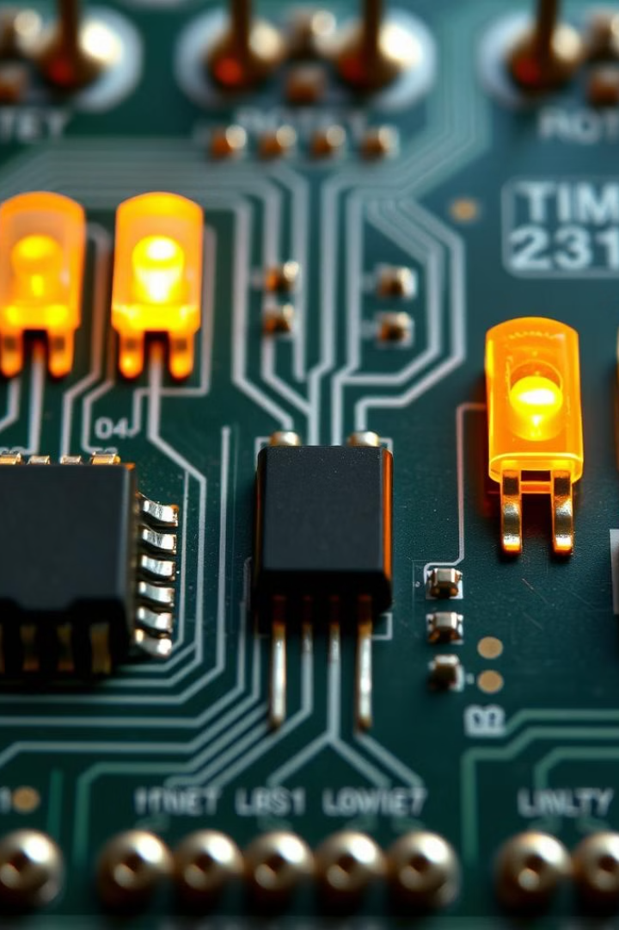
The Limitations of Classical Computing
1
Physical Constraints
2
Exponential Growth
Classical computers are constrained by the physical limits of transistors and the laws of classical physics.
As computing demands increase, classical systems struggle to scale, leading to performance bottlenecks.
3
Simulation Challenges
Simulating complex quantum systems is an immense challenge for classical computers due to the exponential growth of computational resources required.

Slide 3

Quantum Mechanics and Qubits
1
Superposition
Quantum systems can exist in a superposition of multiple states simultaneously, unlike classical bits which are limited to 0 or 1.
2
Entanglement
Qubits can become entangled, where the state of one qubit is dependent on the state of another, enabling powerful computational capabilities.
3
Quantum Tunneling
Quantum effects like tunneling allow qubits to transition between states without the classical energy barriers, further enhancing quantum computing's potential.

Slide 4
Quantum Algorithms and Computational Speedups
Shor's Algorithm
Grover's Algorithm
Quantum Simulation
Capable of factoring large numbers exponentially faster than classical computers, threatening the security of current cryptographic systems.
Provides a quadratic speedup for searching unstructured databases, an important capability for fields like machine learning.
Quantum computers can efficiently simulate the behavior of quantum systems, enabling breakthroughs in material science and chemistry.

Slide 5
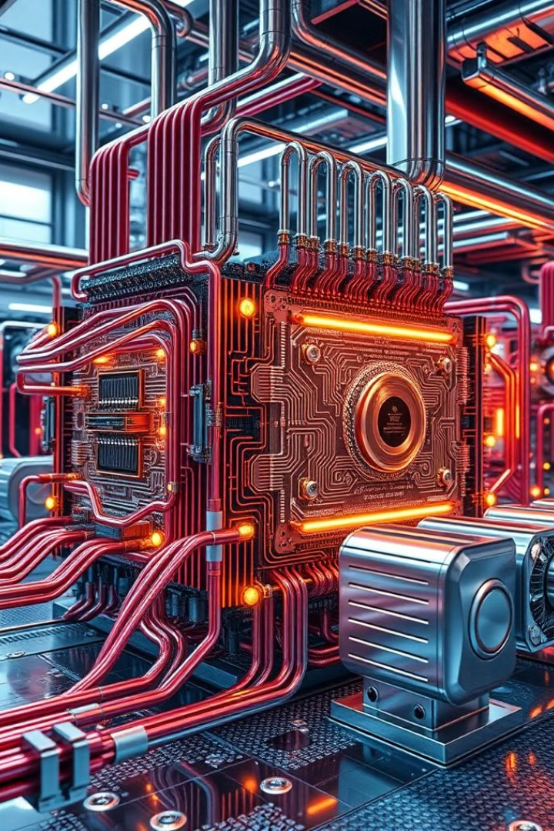




Quantum Hardware and Quantum Supremacy
Qubits
Cryogenic Cooling
The fundamental building blocks of quantum computers, which can exist in superposition and become entangled.
Quantum systems must be isolated from environmental interference, requiring powerful cryogenic cooling systems to maintain the necessary conditions.
Quantum Circuits
Quantum Supremacy
The carefully engineered superconducting circuits that control the state and interactions of qubits to perform quantum computations.
The milestone of a quantum computer outperforming the world's most powerful classical supercomputer on a specific task, demonstrating the unique capabilities of quantum computing.

Slide 6
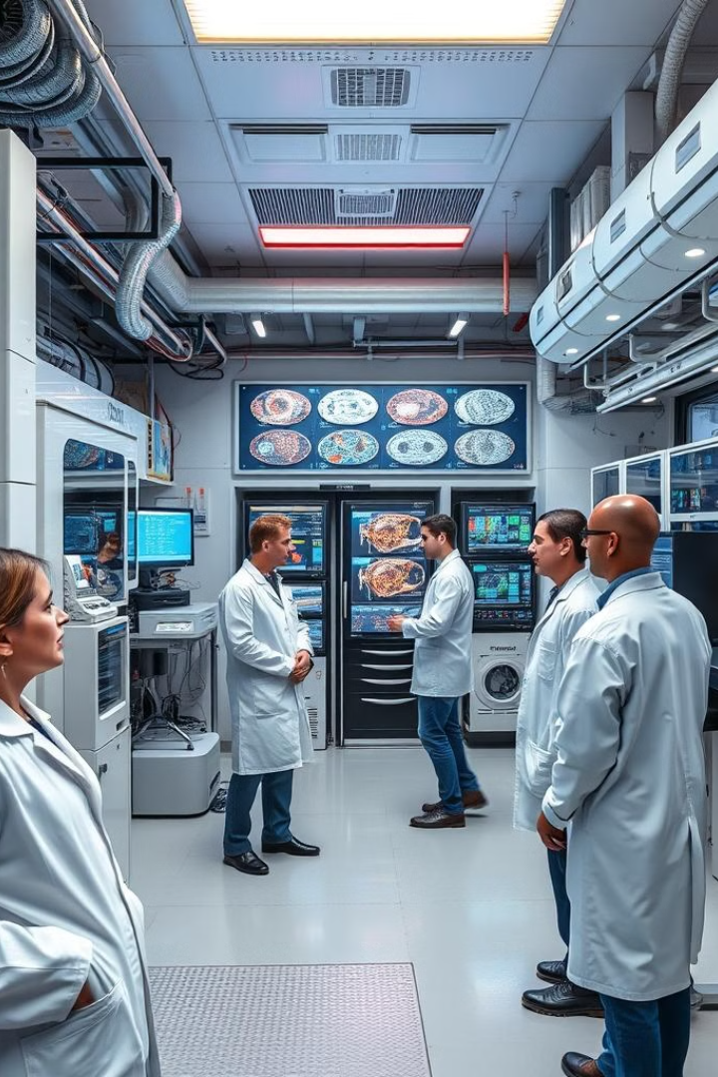
Applications of Quantum Computing
Cryptography
Drug Discovery
Quantum computers can rapidly factor large numbers, threatening the security of current encryption methods. This drives the need for quantum-resistant cryptography.
Quantum simulations can model the complex behavior of molecules, accelerating the discovery and development of new drugs and materials.
Optimization Problems
Artificial Intelligence
Quantum algorithms can solve certain optimization problems exponentially faster than classical computers, with applications in logistics, finance, and machine learning.
Quantum computing may revolutionize machine learning by enabling more powerful and efficient algorithms for tasks like pattern recognition and data analysis.

Slide 7
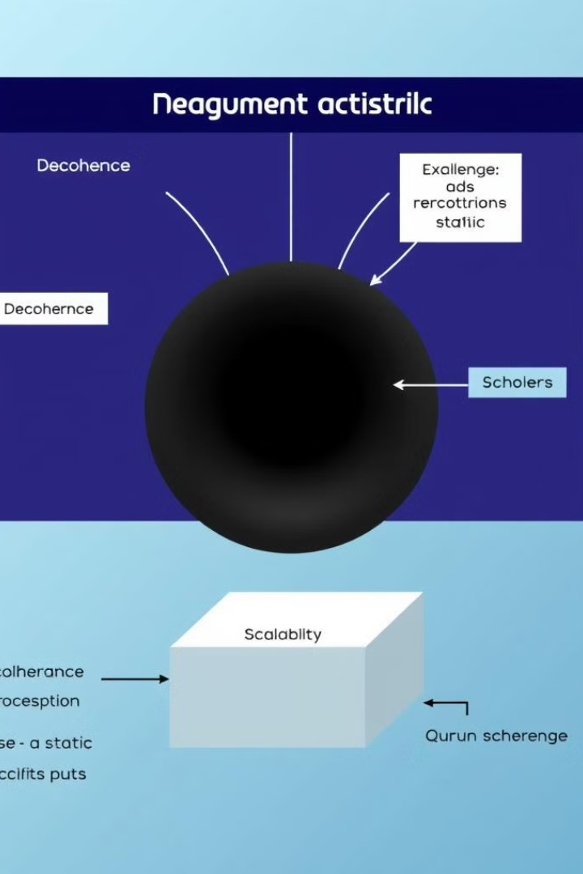



Challenges and Roadblocks
Decoherence
Maintaining the delicate quantum states required for computation is a major challenge, as qubits are highly susceptible to environmental interference.
Scalability
Building large-scale, fault-tolerant quantum computers with enough qubits to outperform classical systems on real-world problems remains an immense technical hurdle.
Programming Complexity
Developing efficient quantum algorithms and programming quantum computers requires expertise in both quantum mechanics and computer science, posing a significant barrier to wider adoption.

Slide 8

The Future of Quantum Computing
1
Continued Advancement
Rapid progress in quantum hardware, algorithms, and error correction techniques will drive steady improvements in the performance and reliability of quantum computers.
2
Practical Applications
As quantum computers become more powerful and accessible, they will unlock transformative applications in fields like cryptography, drug discovery, and artificial intelligence.
3
Societal Impact
The arrival of practical quantum computing will have profound implications for industries, economies, and even national security, requiring careful planning and policy development.

